Slide 1


Slide 2
What is StonePlacing?
Stone Placing is a completely free on-line course that aims to increase the capacity of workers in laying natural stone.
Improve qualification and employability by implementing a common European curriculum with the support of ICT based tools.
Stone Placing wants to ensure the quality of the final work and safety of workers.

Slide 3
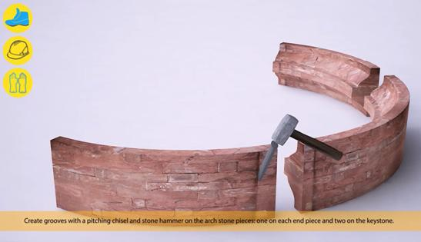
StonePlacing’s Method
There are two types
of contents:
- Curriculum
- Resource Center
Users can freely manage the time and schedule
dedicated to the course.

Slide 4

Curriculum
Norms, procedures and methods for placing the different stonemasonry products.
Adapted to the transversal needs of stone industry across Europe.
Available in PDF.

Slide 5
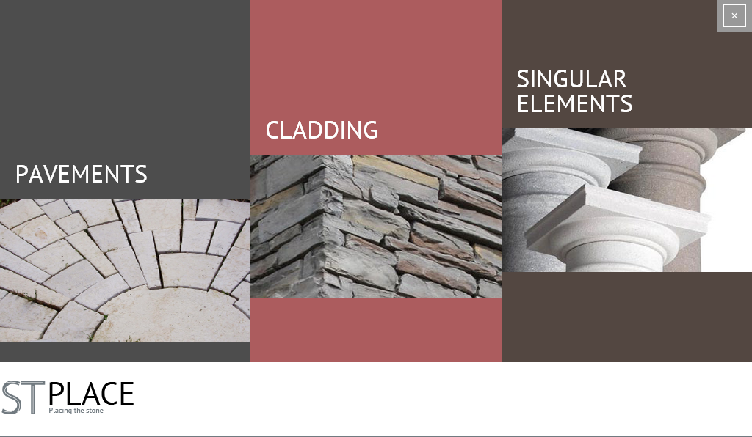
Resource center
Practical demonstrations on topics related to the placement of the stone elements.
Made through
multimedia
material.
(Over 20 animations)
Content divided
in three working areas:

Slide 6

Target users
Young people following courses in VET.
Workers in continuous training and companies.
Stone Technicians.

Slide 7

Who has created StonePlacing?
Developed by partners from German, Spain, France, Sweden, Croatia and Romania.
Funded by the European Union
within the “Leonardo Da Vinci”
program.
This project has been funded with support from the European Commission. This publication reflects the views only of the
author, and the Commission cannot be held responsible for any use which may be made of the information contained
therein.

Slide 8
Meet StonePlacing partners
Contractor: Deutscher Naturwerkstein-Verband – Germany
Coordinator: Asesoramiento, Tecnología e Investigación, S.L AtinServices - Spain
Centro Tecnológico del Mármol – Spain
European Association of Natural Stone, EUROROC – Germany
Institute de la Pierre, Les Compagnons du Devoir - France
Göinge Utbildningscenter – Sweden
Klesarka Skola – Croatia
S.C. Concept Consulting, SRL - Romania

Slide 9


StonePlacing on Social Nets!
StonePlacing has presence on Facebook and Twitter.
/StonePlacing
Follow us to be updated with great news about them
project and the snote placing news and opportunities!

Slide 10

Thank you for your interest in StonePlacing
Please, feel free to:
Contact us if you need further information.
Use or publish StonePlacing on your own webpage or any other way you own to disseminate it.
www.stoneplacing.com

